Slide 1
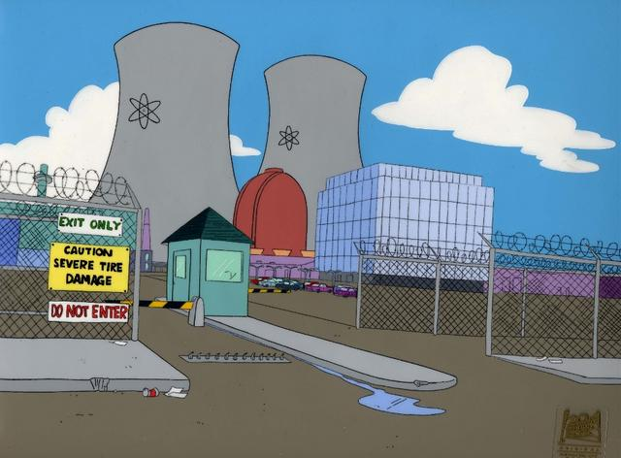
Chemistry
Social Justice Week 2010

Slide 2
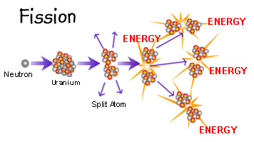
Nuclear Fission
Nuclear Fission involves bombarding an isotope with a neutron, which causes the isotope to break up.
This releases massive amounts of energy.

Slide 3
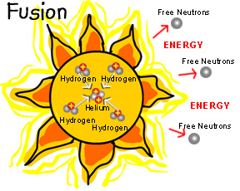
Nuclear Fusion
In Nuclear Fusion, energy is released when atoms are combined or fused together to form larger atoms
At the moment it is only in the experimental stages and it is still unclear if it will ever be a viable option.

Slide 4
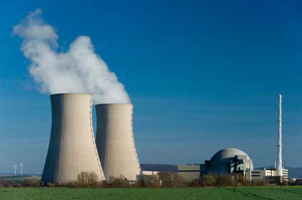
Advantages of Nuclear Power
It is inexpensive as compared to other fuel types
It will not run out in the near future and therefore is seen as a better alternative to fossil fuels.
Nuclear power stations do not produce pollution.

Slide 5
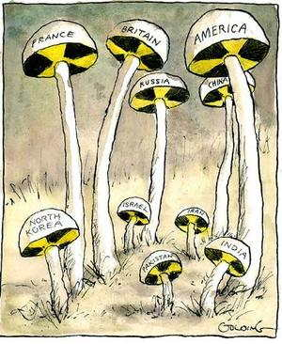
Disadvantages of Nuclear Power
Dangerous waste products are produced
These products do not decompose and need to be stored safely
When accidents occur with nuclear power, the results are devastating.

Slide 6
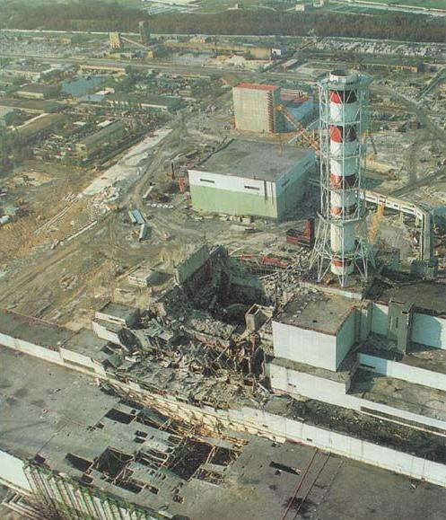
Chernobyl
On 26th of April 1986, a reactor at the Chernobyl Power Plant in what is now the Ukraine suffered a massive power excursion, releasing 4 times more fallout than the atomic bombing of Hiroshima.
56 people died as a direct result of the accident, with thousands more suffering from cancer as a result of radiation exposure.

Slide 7
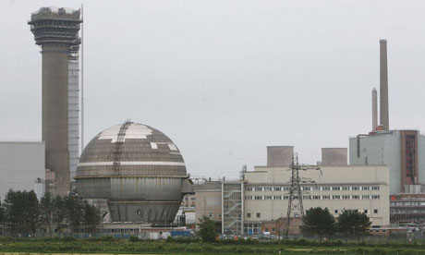
Sellafield
Sellafield Power Plant is in Cumbria, England, beside the Irish Sea.
In the 1940’s and 1950’s in a hasty effort to build the ‘British Bomb’ Sellafield diluted radioactive waste and discharged it into the Irish Sea. As a result it remains one of the most contaminated seas in the world.

Slide 8
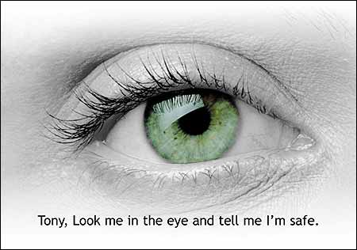
Irish Objections to Sellafield
If a major accident were to occur at Sellafield, Ireland would be left seriously contaminated because of it’s close proximity to the plant.
Many believe that we should not have to put up with such risks, as the Irish public does not benefit in any way from the plant.

Slide 9

What our Government is Doing
The Irish government has made formal complaints about Sellafield to the British.
They have recently reached an agreement which allows the Gardaí and the Radiological Society of Ireland access to the site.
However, the official policy is still to seek the closure of Sellafield.

Slide 10
Links
http://www.nrc.gov/reading-rm/basic-ref/students/animated-pwr.html
http://www.epa.gov/radtown/

